Slide 1
Full face image retrieval based on occluded face
Mentor: Dr. Shiv Ram Dubey
Group Code : SRD005
Team Details:
Venkata Sri Mukhesh Inturi (S20170010056)
Kothagorla Krishna (S20170010078)
Sai Santhosh Chirag (S20170010134)

Slide 2
Contents
Problem Statement
Literature Review
Solution Proposal
Dataset
Dataset-Sample Images
Flow Diagram
Workflow
Work Done After Eval2
Results
References

Slide 3
Problem Statement
The aim of our project is to retrieve full face image of a person from the database given a query of occluded image of the same person.

Slide 4
Literature Review: [1]
This paper uses a method that extracts local face descriptors only from the non-occluded facial areas.
It divides face images into several local regions.
A support vector machine(SVM) is trained to identify which local regions are occluded and then they are discarded from recognition.
This kind of approach is limited in view of shallow features like Local Binary Patterns(LBPG).

Slide 5
Literature Review: [2]
This method uses sparse representation based recognition.
This model reconstructs an occlusion-free face using a linear combination of images from the training set together with a sparse constraint term accounting for occlusions.
Drawback of this model is the reconstructed portion of the image may be different from the actual image.

Slide 6
Literature Review: [3]
In this paper, the author presented an Long Short Term Memory(LSTM) - Autoencoder to restore occluded facial areas and carried out recognition on the recovered facial images.
But, the correctness of recovered image matching the identity of individuals is not guaranteed.

Slide 7
Solution Proposal
We use a mask learning strategy to find and discard corrupted feature elements due to occlusion.
A mask dictionary is firstly established by exploiting the differences between the top conv features of occluded and occlusion free face pairs using pairwise differential siamese network (PDSN).

Slide 8
Dataset-Custom LFW
We created custom LFW dataset. It consists of 13k images of 5749 individuals.
We created a custom dataset of 2,64,075 images by creating 25 images for each image of a person.
Each of the 25 images has one block occluded.

Slide 9

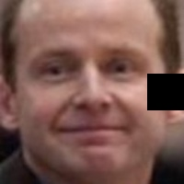
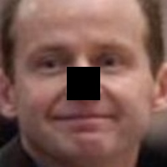
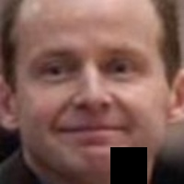
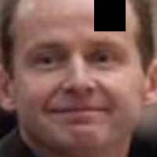
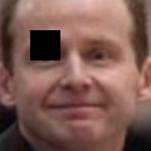
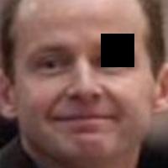
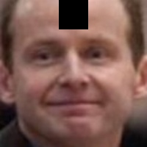
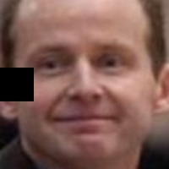
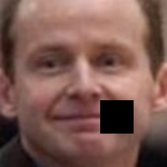
Dataset - Sample Training Images

Slide 10
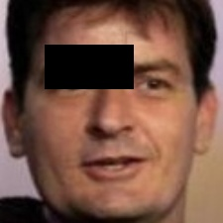
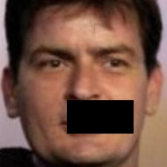
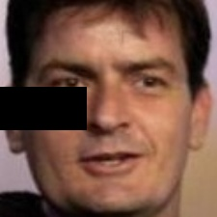
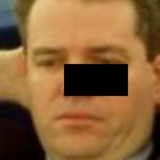
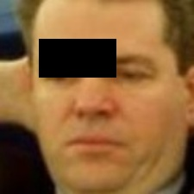
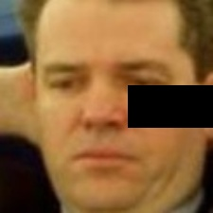


Dataset - Sample Testing Images

Slide 11
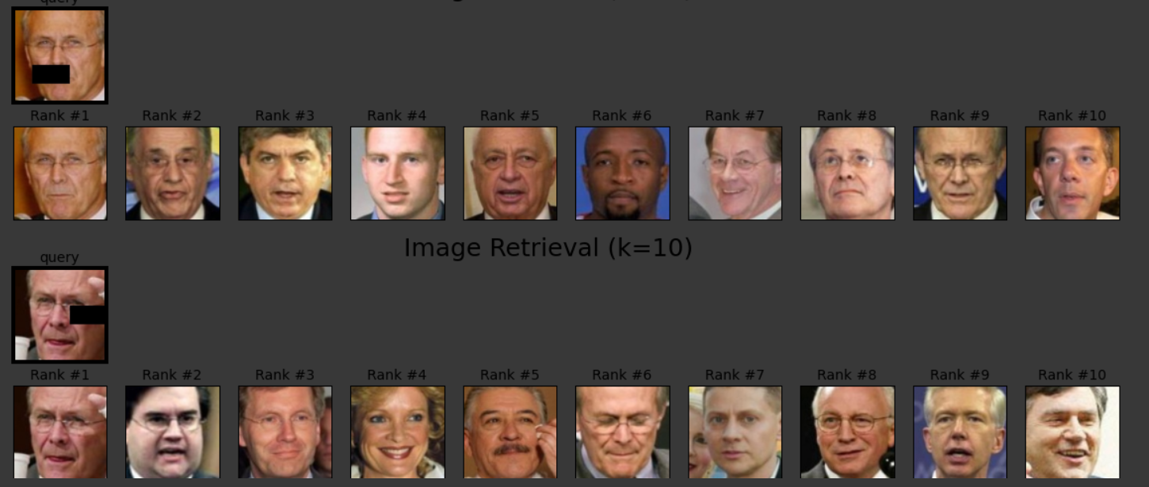
Flow Diagram
Image Database
Query Image
Mask top conv features
Feature Extraction
From fc layers
Compare feature vectors based on distance metric
Feature Extraction
From fc layers
Mask top conv features
Retrieve the top K images

Slide 12
Workflow
Stage I:Constructing pairwise differential siamese network (PDSN) using RESNET50.
Stage II: Establishing a mask dictionary to capture the correspondence between occluded facial blocks and corrupted feature elements.
Stage III: This is the testing phase.

Slide 13
Work Done After Eval2
Stage I (done): We built Pair Wise Differential Siamese Network.
Stage II (done):We constructed Mask Dictionary using 50,000 images from our custom LFW dataset and performed retrieval.
Stage III : The current recall for our model is 0.69.

Slide 14
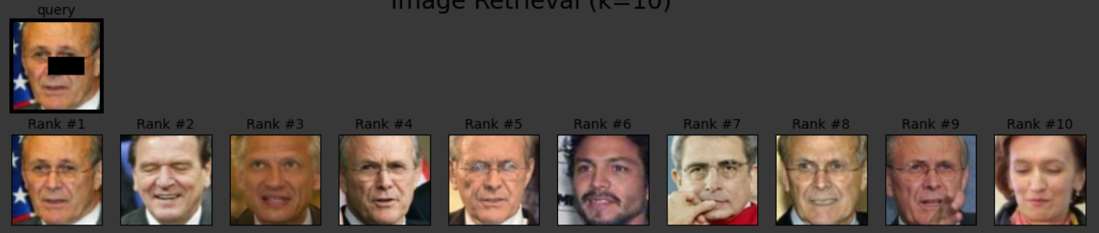
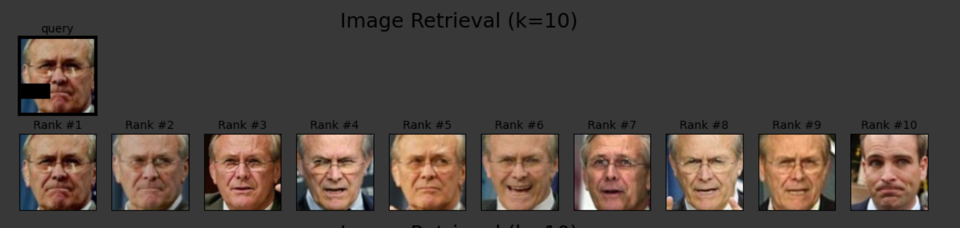
Sample Results

Slide 15
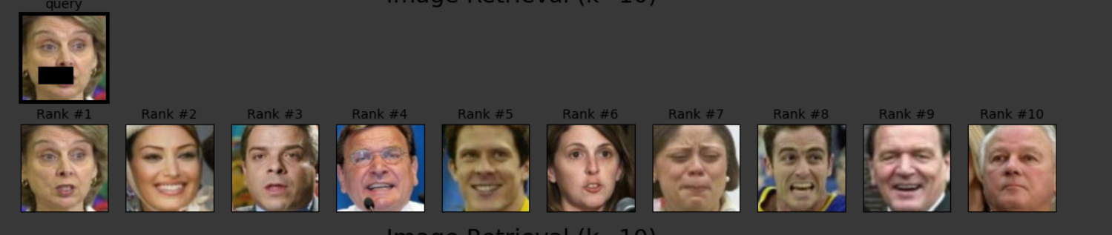
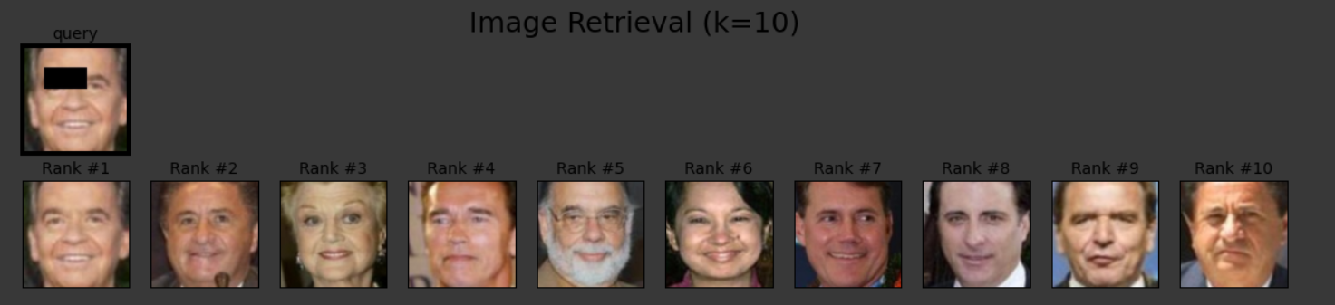
Sample Results(contd..)

Slide 16
Work done after eval3
Optimised of retrieval process
Built a django based web application for our project

Slide 17
Optimisation of retrieval process
We found out that most of the retrieval time is consumed for extracting the feature vectors of the images in the database.
We had to extract the feature vectors for every image in the database and then compare them with the input test image.
So we have stored the feature vectors as PyTorch tensors in .pt file extension.
We used those feature vectors for retrieval.
We made the retrieval process 10x times faster.

Slide 18
Django web application
We build a Django based web application which takes the occluded image as input.
It runs our model in the back-end and retrieves the closest images from the database.
The retrieved images are then displayed back to the user in the same page.

Slide 19
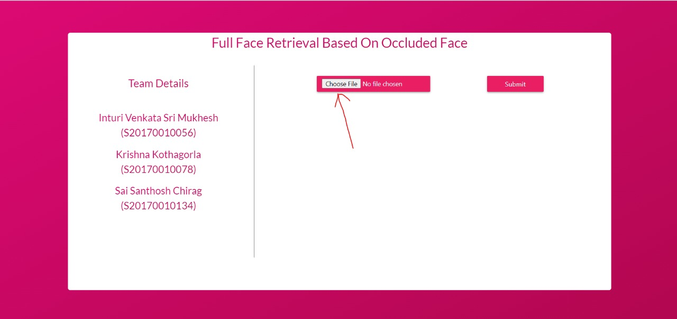

Slide 20
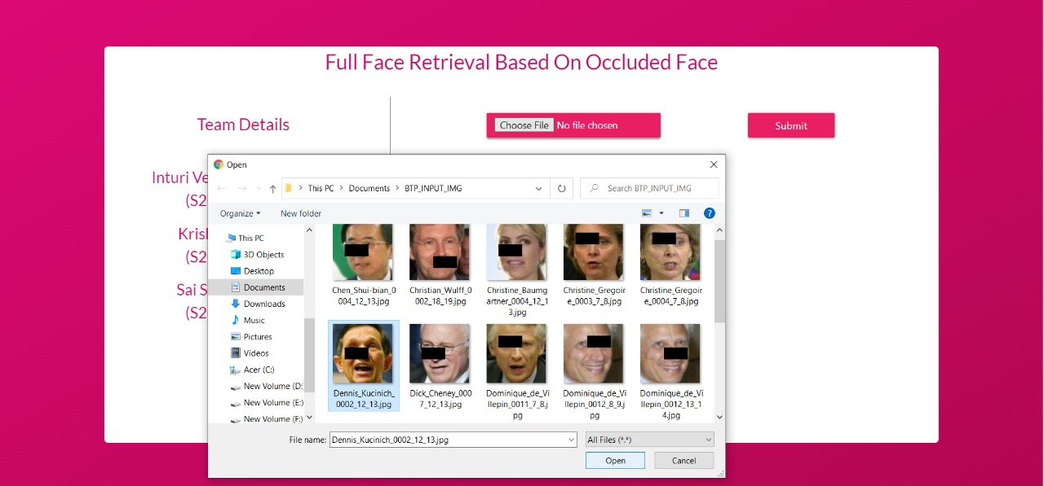

Slide 21
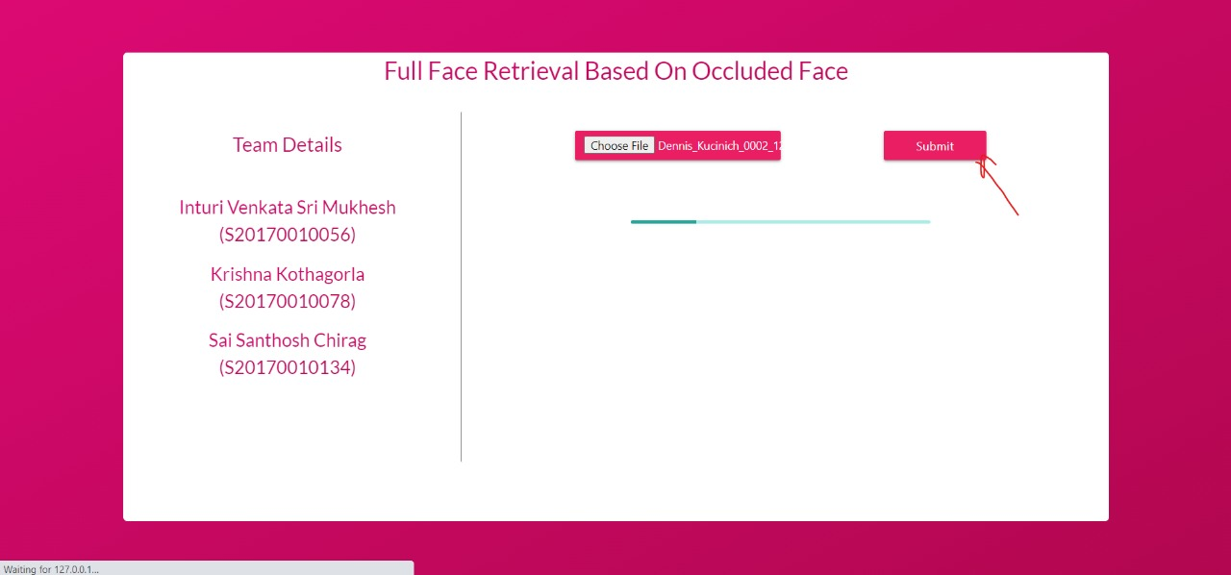

Slide 22
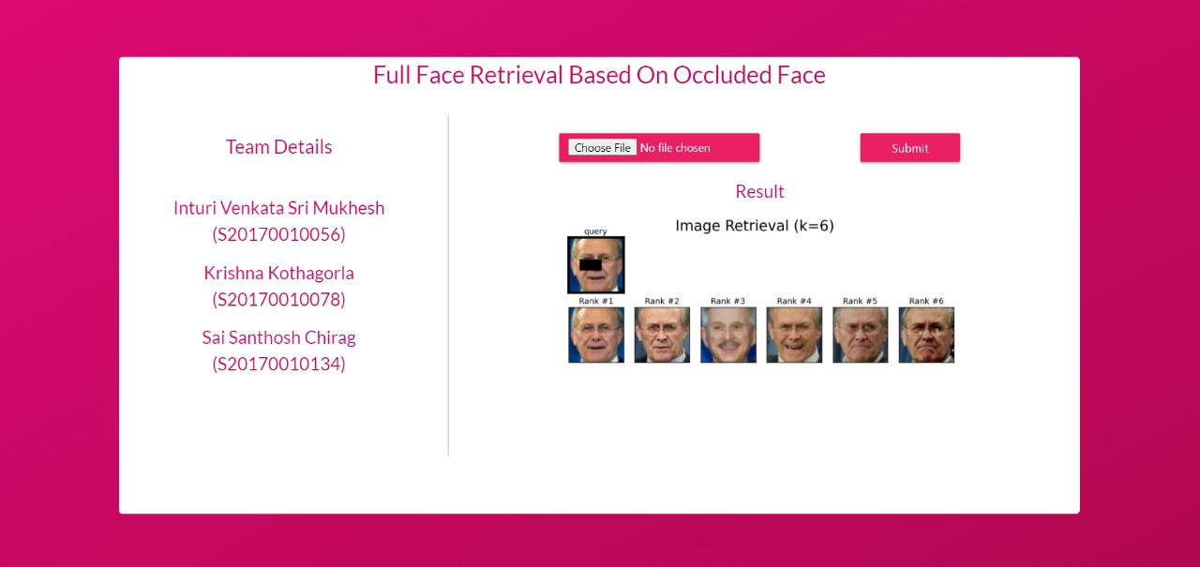

Slide 23
References
Zhifeng Li,Wei Liu, Dahua Lin, and Xiaoou Tang. Nonparametric subspace analysis for face recognition. In IEEE Conference on Computer Vision and Pattern Recognition, pages 961–966, 2005.
Meng Yang, Lei Zhang, Jian Yang, and David Zhang. Robust sparse coding for face recognition. In IEEE Conference on Computer Vision and Pattern Recognition, pages 625–632, 2011.
Fang Zhao, Jiashi Feng, Jian Zhao, Wenhan Yang, and Shuicheng Yan. Robust lstm-autoencoders for face deocclusion in the wild. IEEE Transactions on Image Process- ing, 27(2):778–790, 2018.

Slide 24
References
4. L. Song, D. Gong, Z. Li, C. Liu and W. Liu, "Occlusion Robust Face Recognition Based on Mask Learning With Pairwise Differential Siamese Network," 2019 IEEE/CVF International Conference on Computer Vision (ICCV), Seoul, Korea (South), 2019, pp. 773-782, doi: 10.1109/ICCV.2019.00086..

Slide 25
Thank You

